Slide 1
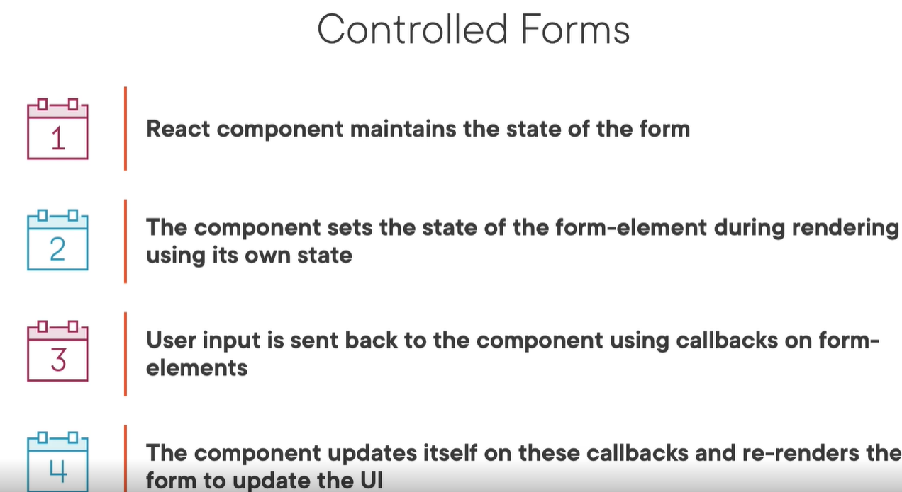
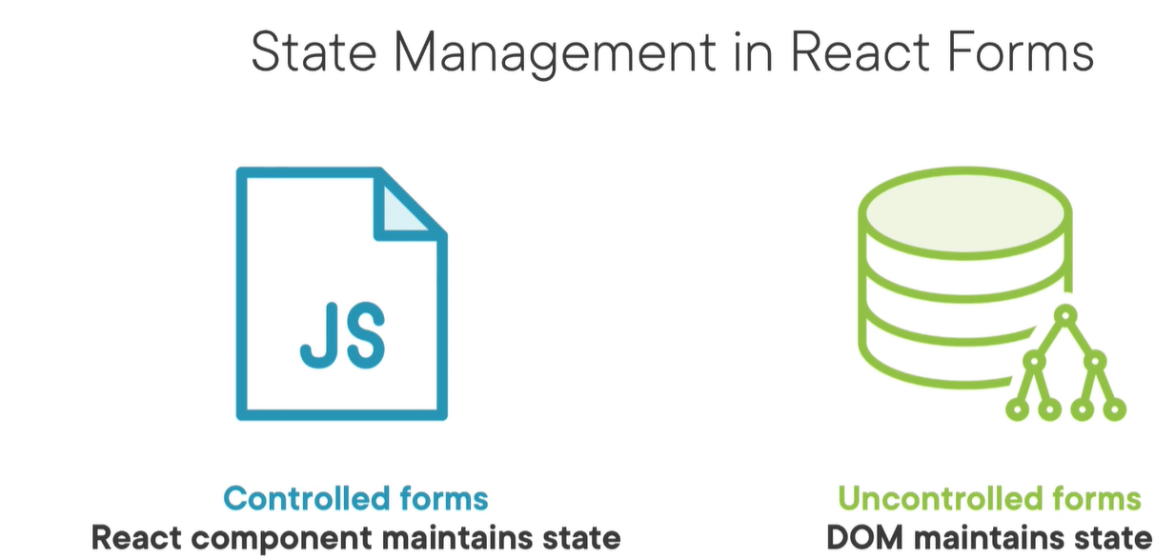
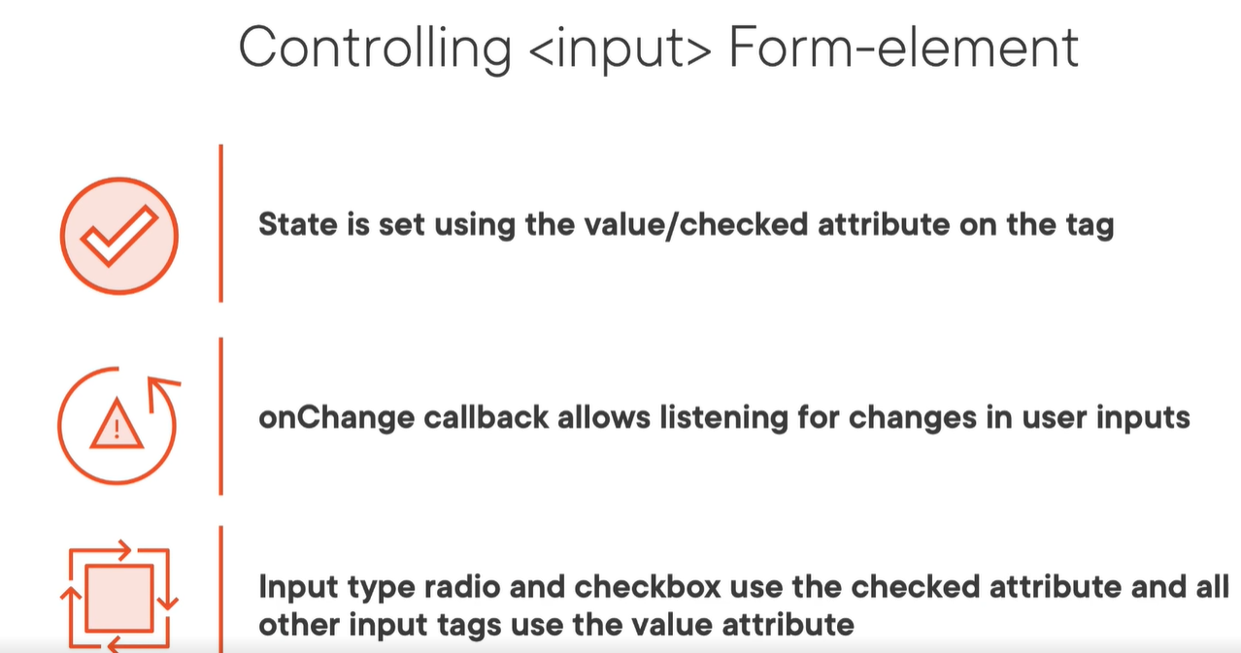
Create controlled forms using vanilla react
The forms in react has to maintain internal state for the user input until the form is submitted.
In react we have 2 approches for handling the forms state: based on the used approach the forms are: controlled and uncontrolled.
Controlled forms are the most used ones & they are the recommended ones. Their state is handled by React component.
The uncontrolled forms state is handled by DOM and
They are very closed to the native html forms.
constructor(props){
super(props);
this.state = {value:''};
this.handleChange = this.handleChange.bind(this);
}
handleChange(event){
this.setState({value: event.target.value});
}
render() {
return (
<form>
<input type="email" value={this.state.value} onChange={this.handleChange} />
</form>
);
}
not good approche creating forms with vanilla, better use formic, instead of vanilla
Notes:
Course Pluralsight:
Creating Asynchronous TypeScript Code – Lector: John Papa
https://app.pluralsight.com/library/courses/typescript-asynchronous-code/table-of-contents

Slide 2
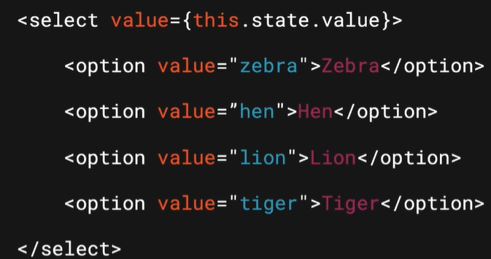
constructor(props){
super(props);
this.state = {value:''};
this.handleChange = this.handleChange.bind(this);
}
handleChange(event){
this.setState({value: event.target.value});
}
render() {
return (
<form>
<input type="email" value={this.state.value} onChange={this.handleChange} />
</form>
);
}
If we put value attribure in the input tag this will prevent the user rom changing the input. The input now can be changed only via onChange event.
This is valid also for textarea tag, seect tag

Slide 3
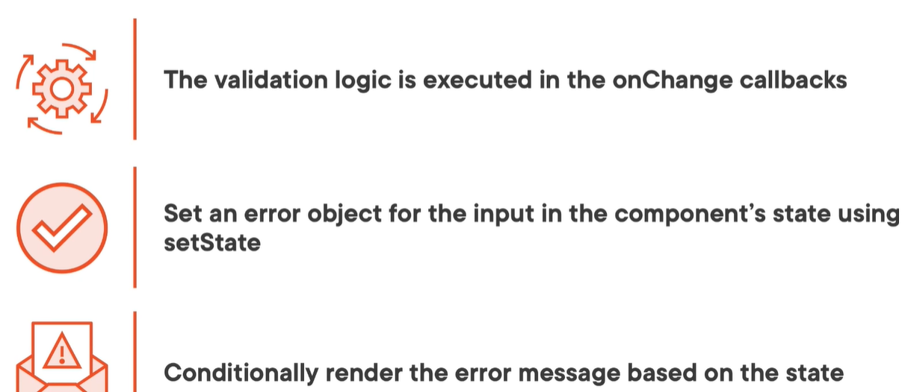
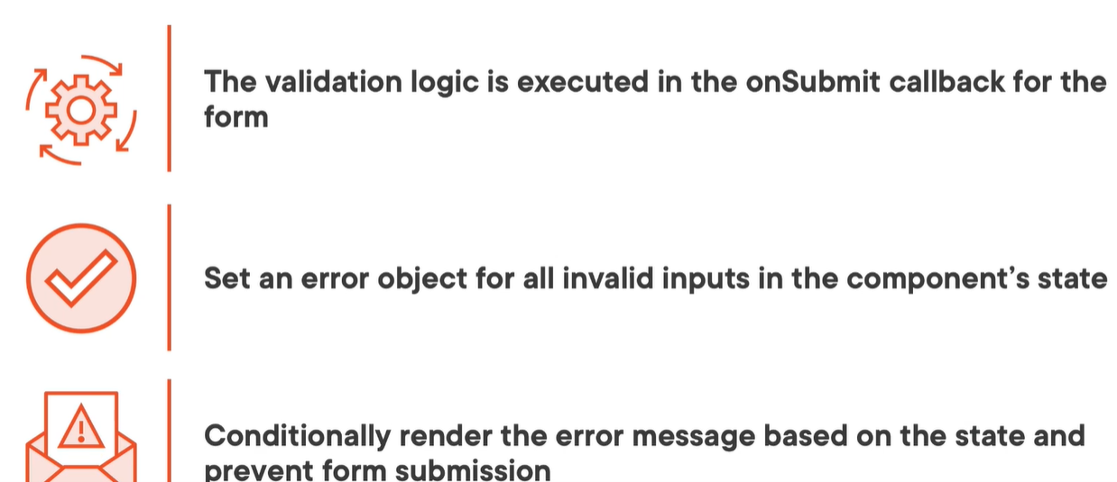
Data validation in forms
Validation triggers
-onChange -> this is great to give direct user feedback ->for example on password fields
-onSubmit ->this provides feedback when the user hits the btn submit
//On submit
Add new state object for the error : EmailError
this.state = {
email: "",
password: "",
rememberMe: false,
emailError: ""
}
2. In the onChange callback reset the error fields
handleEmailInputChange(e) {
this.setState({email: e.target.value, emailError: ""})
}
3. In handleSubmit method add the business logic for the error handling
handleSubmit(e) {
var emailError = ""
if(!this.state.email) {
emailError = "Email can't be empty"
}
if(emailError) {
this.setState({emailError})
e.preventDefault()
} else {
alert(JSON.stringify(this.state))
}
<Form onSubmit={this.handleSubmit}>
<Label>Email</Label>
<EmailInput type="email"
value={this.state.email}
onChange={this.handleEmailInputChange}/>
{this.state.emailError && <ErrorLabel>{this.state.emailError}</ErrorLabel>}

Slide 4
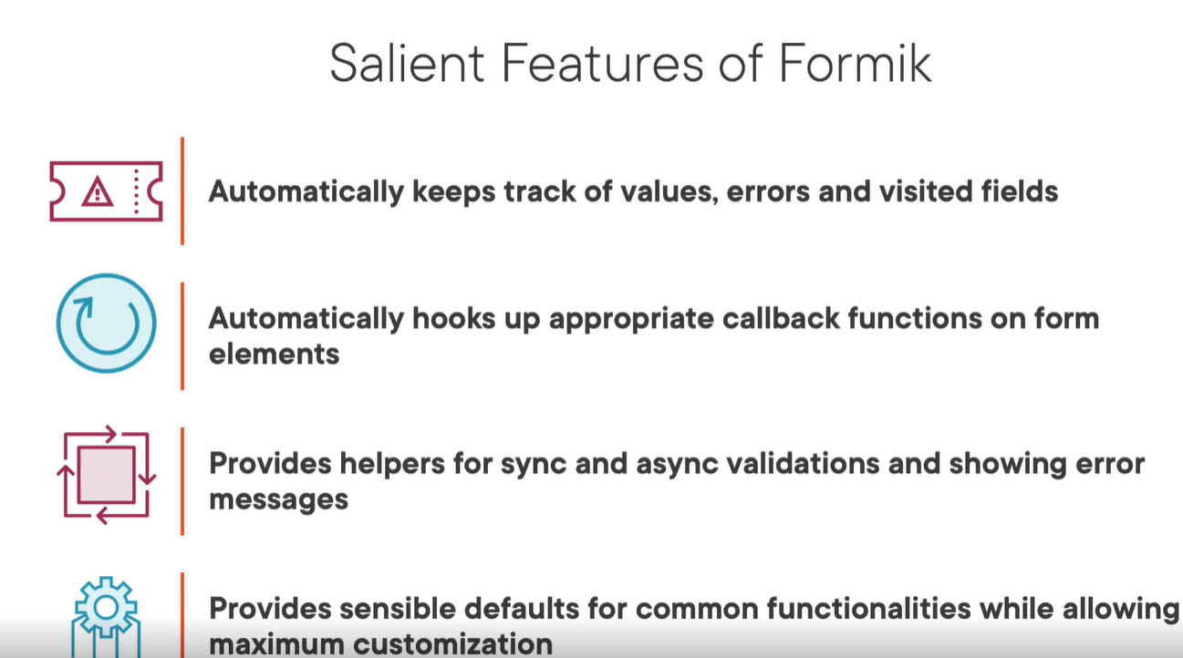
Formic forms
Setting up formic
Install it : npm install formic –save
then use
import { Formik, Field, Form, ErrorMessage } from 'formik';
Formic components
<Formik> <Form> <Field> <ErrorMessage>

Slide 5
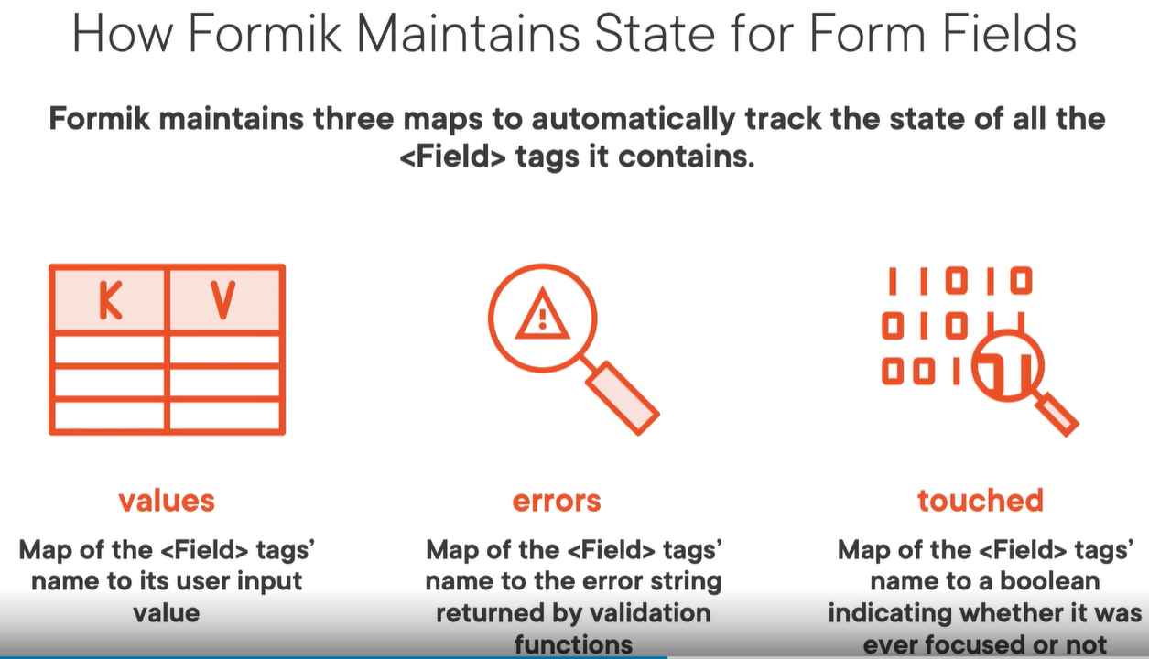
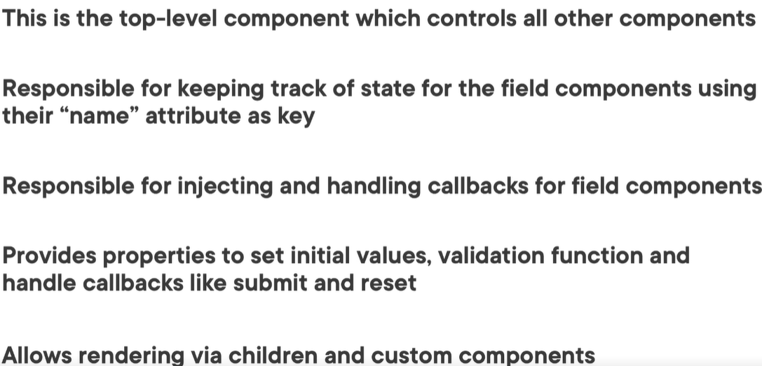
Formik component
<Formik>

Slide 6
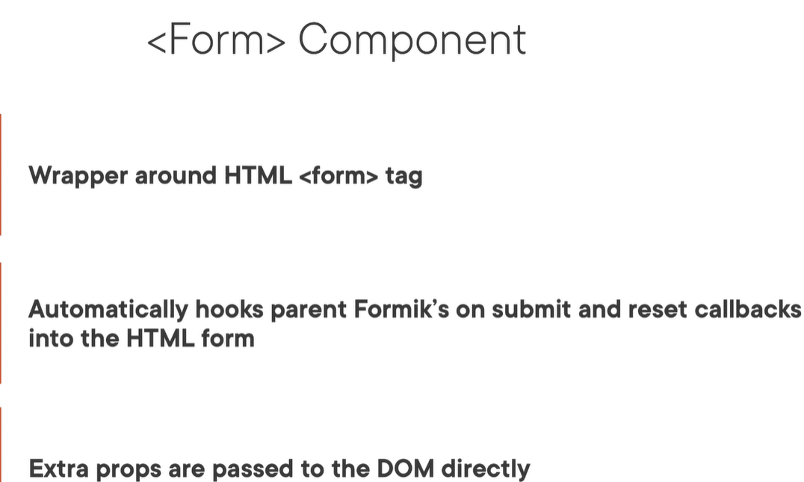
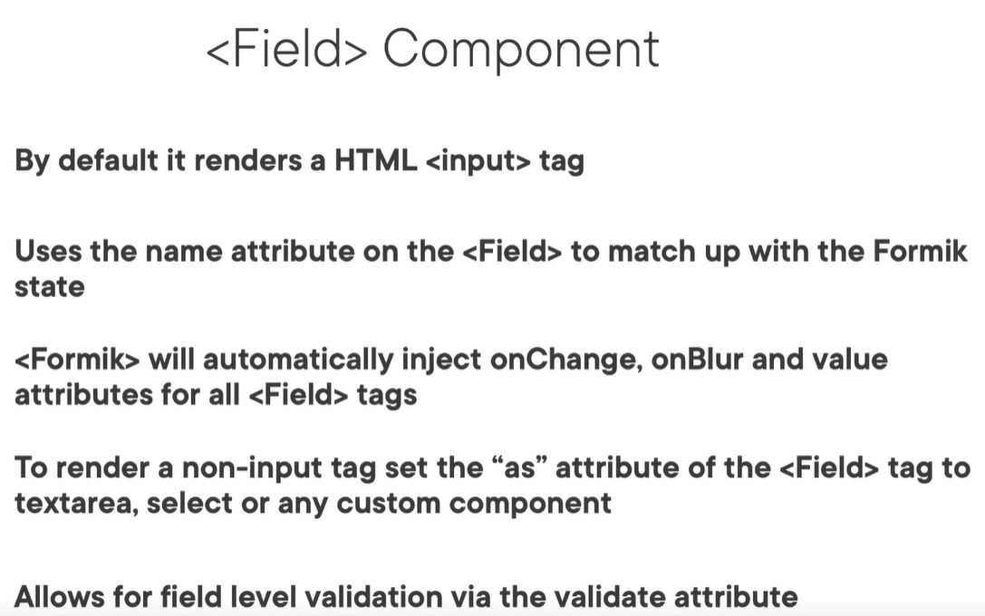
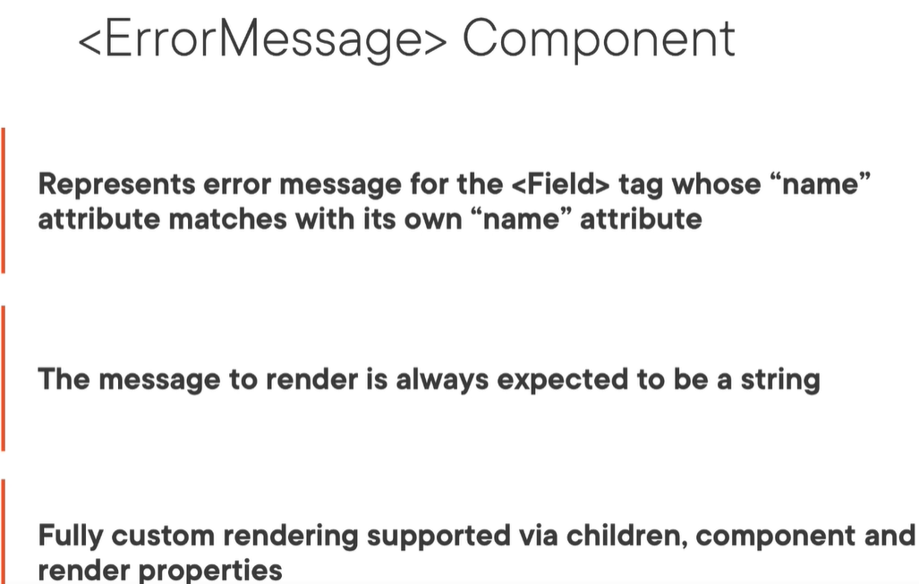
Form,field, error comps in formic form

Slide 7
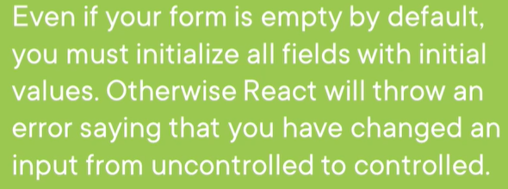
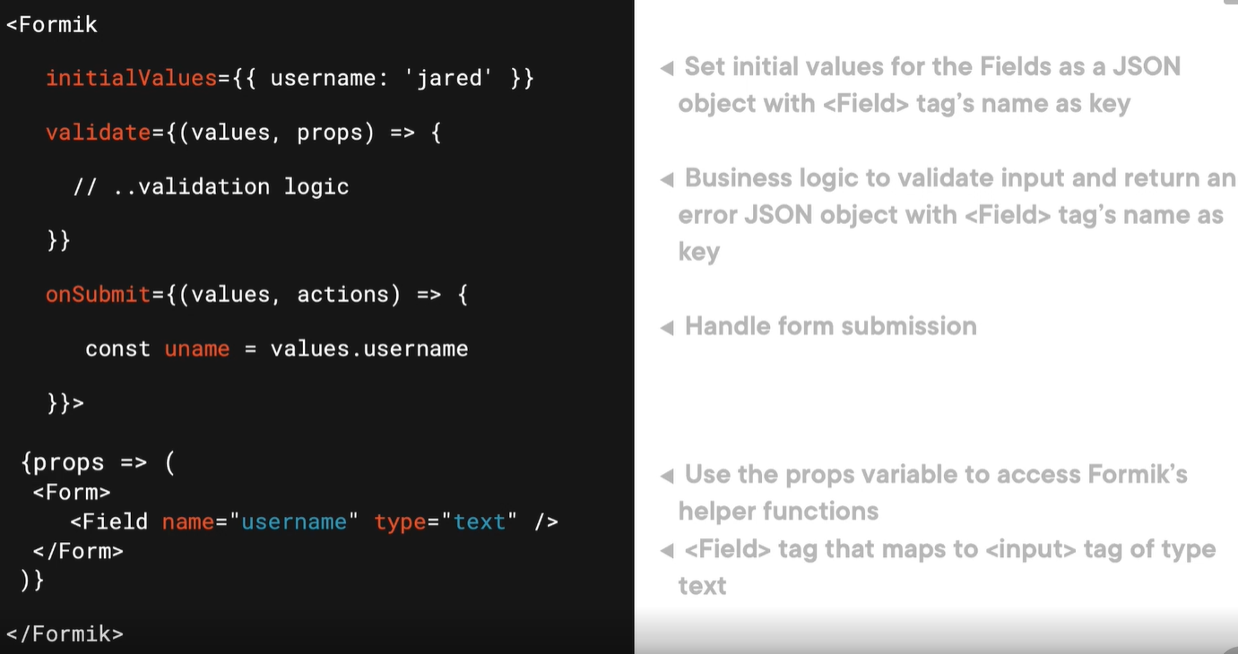
Formic form example

Slide 8
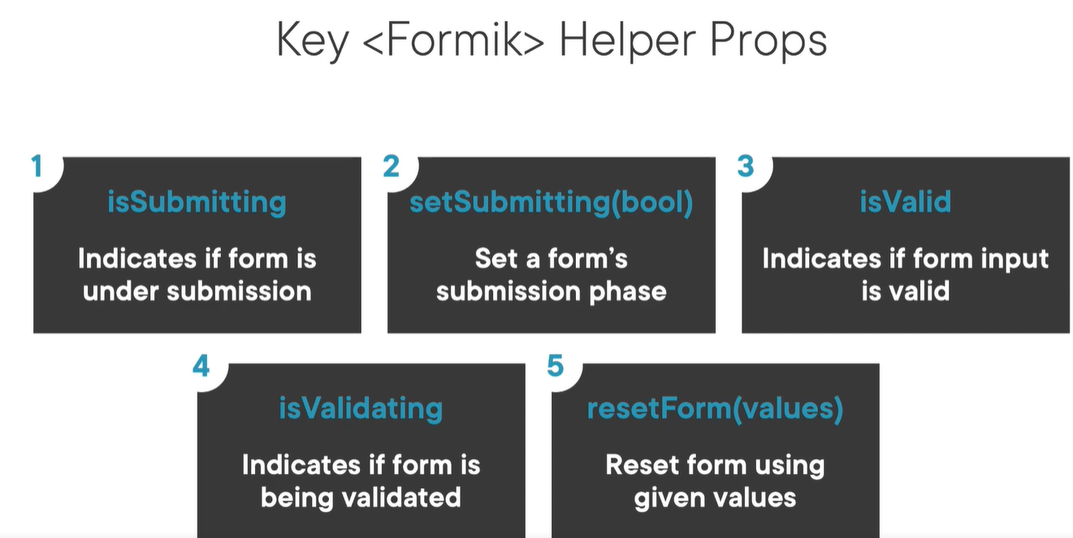
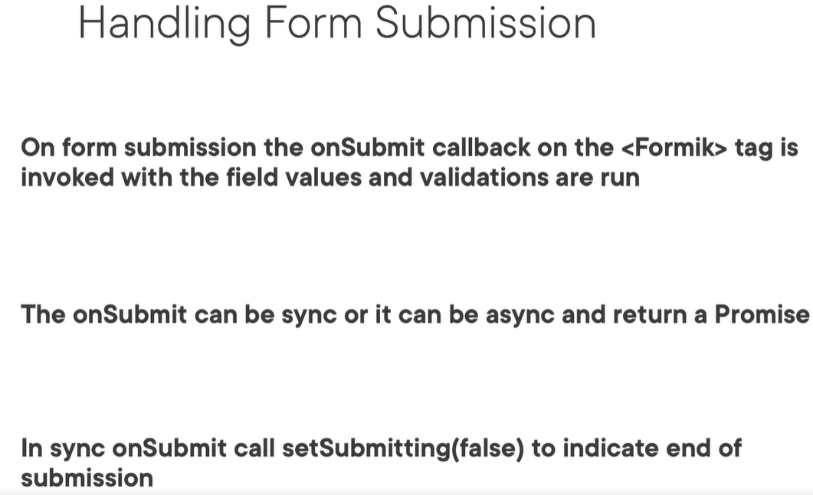
Handling formic form submission

Slide 9
Formic form
const SignInForm = styled(Form)`
display: flex;
flex-direction: column;
padding:30px;
border:1px solid black;
` const EmailField = styled(Field)`
height:40px;
font-size:24px;
`
const PasswordField = styled(Field)`
height:40px;
font-size:24px;
`
class SignInComponent extends React.Component {
constructor(props) {
super(props);
//formic form callbacks handling
this.handleSubmit = this.handleSubmit.bind(this);
this.handleValidation = this.handleValidation.bind(this);
}
handleSubmit(values, actions) {
return new Promise( (resolve, reject) => {
setTimeout(() => {
resolve()
alert(JSON.stringify(values))
}, 5000)
});
}
handleValidation(values) {
const errors = {}; if(!values.email){
errors.email = "Email can't be empty"
}
if(!values.password){
errors.password = "Password can't be empty"
} return errors;
}
render() {
return (
<Container>
<ContentContainer>
<Title>{"Sign In"}</Title>
<Formik initialValues={{email:'', password:'', rememberMe: false }}
onSubmit={this.handleSubmit}
validate={this.handleValidation}
>
{ props => (
<SignInForm>
<Label>Email</Label>
<EmailField name="email" type="email"></EmailField>
<ErrorMessage name="email">
{error => <ErrorLabel>{error}</ErrorLabel>}
</ErrorMessage>
<Label>Password</Label>
<PasswordField name="password" type="password"/>
<ErrorMessage name="password">
{error => <ErrorLabel>{error}</ErrorLabel>}
</ErrorMessage>
<CheckboxContainer>
<RememberMeCheckboxField type="checkbox" name="rememberMe"/>
<CheckboxLabel>Remember me</CheckboxLabel>
</CheckboxContainer>
<SubmitButton type="submit" disabled={props.isSubmitting}/>
</SignInForm>
)}
</Formik>
</ContentContainer>
</Container>
);
}
}

Slide 10
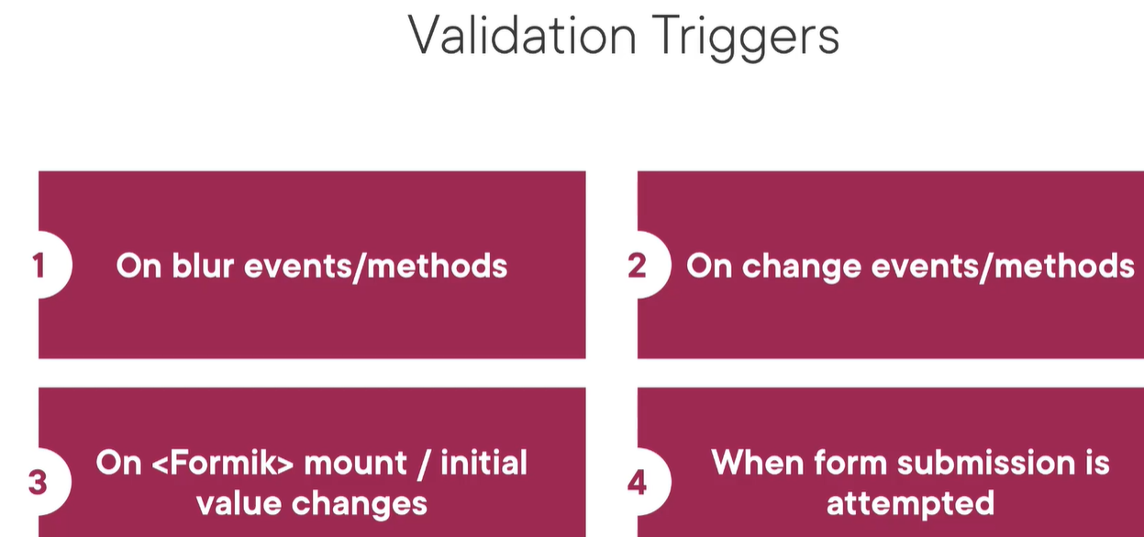
Data validation with formik ->check yup in the next slideS!
2 types of form validation
-form level validation in formik tag ->validates all fields in once (on form submit). Uses either validate or Validationschema props on formik tag. Scema expects a schema from a library like yup
-field level validation in Field tag -> validate the user input in the field tag -> uses validate prop on the field tag
Validation triggers – controlling validation trigger behaviour
validateOnBlur –by default true
validateOnChange –by default true
validateOnMount –by default false
Manually triggering validations on custom events like btn press in the form by the user
Use validateForm() for all the form or validateField(fieldName) -> for field level
isValidating() method to check if the validation is already running
validatePassword(value) {
if(!value){
return "Pass can't be empty";
}
//we use undefined instead of null!
return undefined;
}
<Formik initialValues={{ email: '', password: '', rememberMe: false }}
onSubmit={this.handleSubmit}
validate={this.handleValidation}> //.. Sushtata forma kat prednata str
<Label>Confirm Password</Label>
<PasswordField name="confirmPassword" validate={this.validatePassword} type="password" />
<ErrorMessage name="confirmPassword">
{error => <ErrorLabel>{error}</ErrorLabel>}
</ErrorMessage>
Notes:
YUP ibrary is more cool to use!

Slide 11
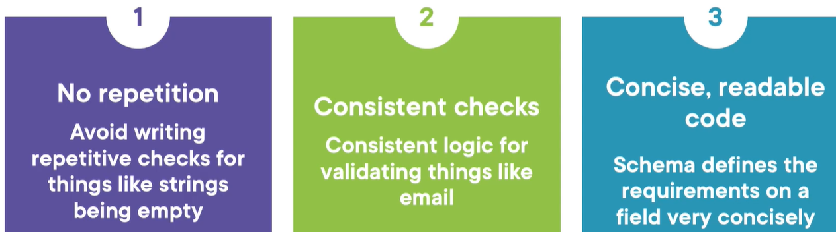
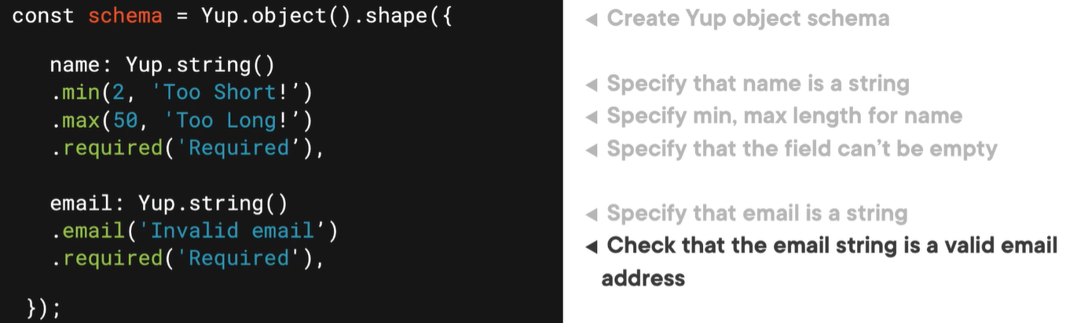
Formik Schema based validation -yup
Why to use
Integrate YUP with formik
Npm install yup –save
-specify the form level schema using the validationSchema prop in Formik tag
-use validate or validateSync methods on schema or manually trigger validations for field level validations

Slide 12
Using yup
import * as Yup from 'yup’;
//define yup schema
//outside the class
const SignupSchema = Yup.object().shape({ //for form level data validation
email: Yup.string().email("Invalid email").required("Email can't be empty")
});
const PasswordSchema = Yup.object().shape({ //field level data validation
password: Yup.string().required("Password can't be empty")
.test('len', "Very weak", val => val.length > 5)
.test('len', "Weak", val => val.length > 8)
});
//in the class validatePassword(value) {
var error = undefined;
try {
PasswordSchema.validateSync({password: value})
} catch(validationError) {
error = validationError.errors[0]
}
return error;
}
//integrate the schema in the form
<Formik initialValues={{ email: '', password: '', confirmPassword: '' }}
onSubmit={this.handleSubmit}
validationSchema={SignupSchema}>
Label>Password</Label>
<PasswordField name="password" validate={this.validatePassword} type="password"/>

Slide 13
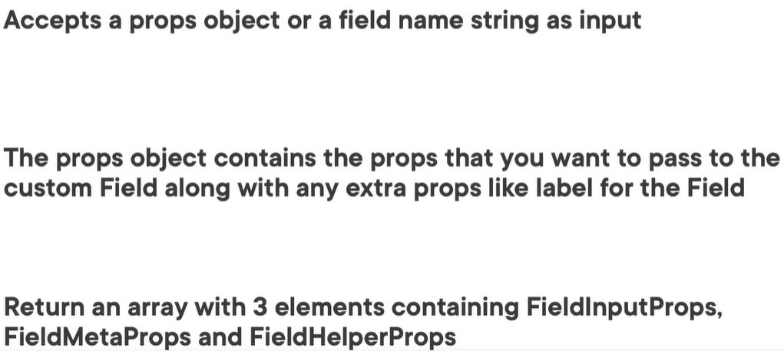
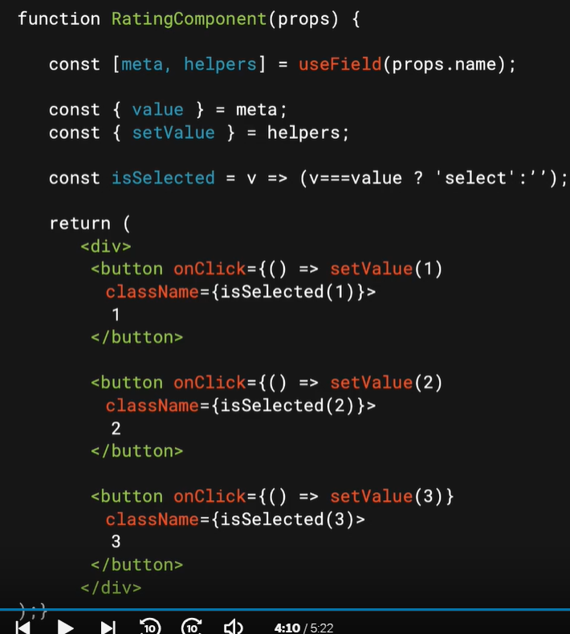
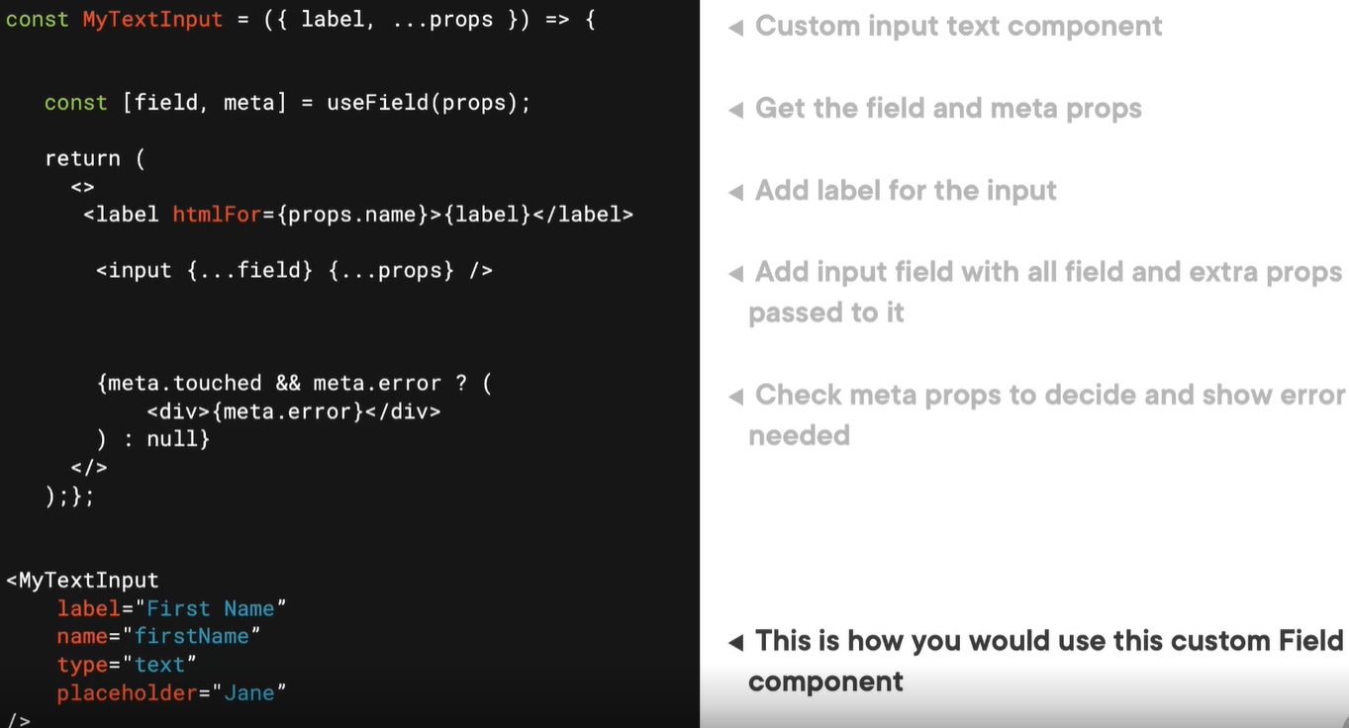
Custom reusable form elements in formic
useField
Formic has useField reakt hook to create custom field input éléments.
FieldInputProps:
Accepts name, value, checked, multiple, onBlur,onChange
FieldMetaProps
Error, touched, value, initialValue
FieldHelperProps
setValue. setTouched, setError
Example 2
Example 1

Slide 14
Create custom email field
import React from 'react';
import styled from "styled-components";
import {useField} from 'formik';
const Container = styled.div`
display: flex;
flex-direction: column;
`
const Label = styled.label`
font-size: 24px;
`
const InputField = styled.input`
`
const ErrorMessage = styled.div`
font-size: 26px;
color: red;
`
//creating custom emailField,
//separating label props from the rest of the props
const EmailField = ({ label, ...props }) => {
const [field, meta] = useField(props);
return (
<Container>
<Label htmlFor={props.id || props.name}>{label}</Label>
<InputField {...field} {...props} />
{meta.touched && meta.error && (
<ErrorMessage>{meta.error}</ErrorMessage>
)}
</Container>
);
};
export default EmailField
Integrating it in our form
<CreateInvoiceForm>
<EmailFieldInput name="email" type="email" label="Client'

Slide 15
Create custom rating field
import React from 'react’; import styled from "styled-components";import {useField} from 'formik';
const Container = styled.div`
display: flex; flex-direction: column;
`
const Label = styled.label`
font-size: 24px;
`
const RatingsContainer = styled.div`
display: flex; margin-top: 5px;
`
const RatingsButton = styled.div`
display: flex; justify-content: center;
..
`
const ErrorMessage = styled.div`
font-size: 26px; color: red;
`
const RatingField = ({ label, ...props }) => {
//extract field, meta & helpers from useField
const [field, meta, helpers] = useField(props.name);
//extract value from meta
const { value } = meta;
const { setValue } = helpers;
return (
<Container className={props.className}>
<Label htmlFor={props.id || props.name}>{label}</Label>
<RatingsContainer name={props.name}>
<RatingsButton onClick={() => setValue(1)} isSelected={value === 1}> 1 </RatingsButton>
<RatingsButton onClick={() => setValue(2)} isSelected={value === 2}> 2 </RatingsButton>
<RatingsButton onClick={() => setValue(3)} isSelected={value === 3}> 3 </RatingsButton>
<RatingsButton onClick={() => setValue(4)} isSelected={value === 4}> 4 </RatingsButton>
<RatingsButton onClick={() => setValue(5)} isSelected={value === 5}> 5 </RatingsButton>
</RatingsContainer>
{meta.touched && meta.error && (
<ErrorMessage>{meta.error}</ErrorMessage>
)}
</Container>
);
};
export default RatingField
Integrate rating field in the form
<RatingFieldInput name="rating" label={"Project Rating"}/>

Slide 16
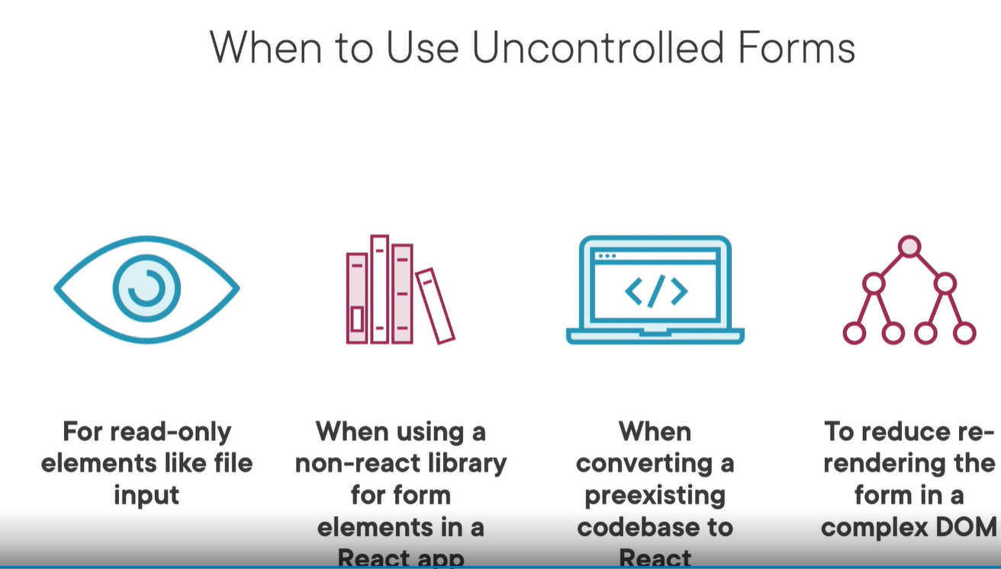
Using uncontrolled forms

Slide 17
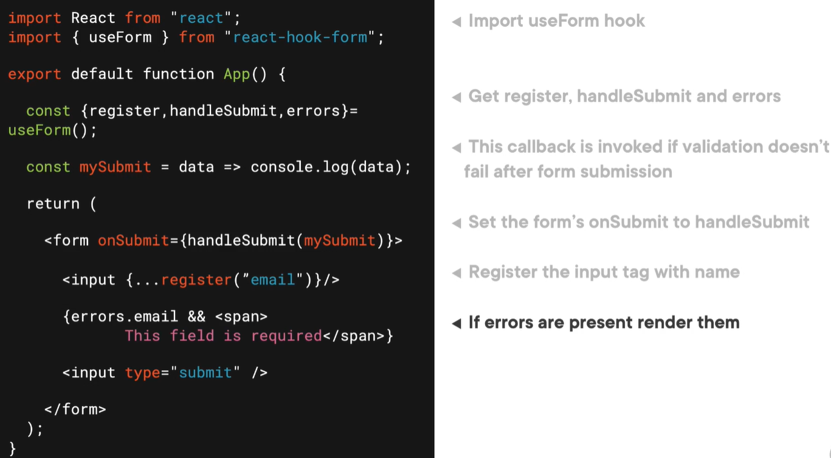
Using react hook FORM to create uncontrolled forms
Controlled forms rerender the entire form on every change in the form ->this is main performance problem thats why we use uncontrolled elemets
I
Npm install react-hook-form
useForm hook to access register, handleSubmit methods and error object
useForm hook accepts config to alter the behaviour of the form
Configs: mode, defaultValues, resolver

Slide 18
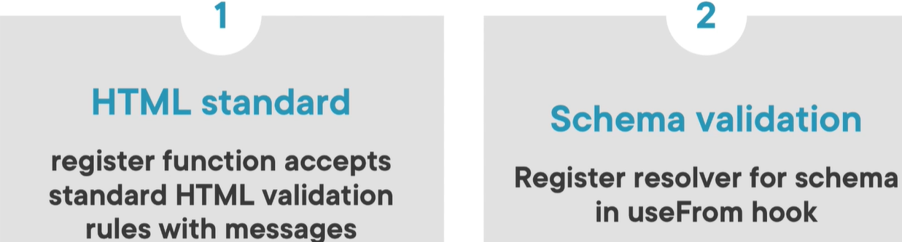
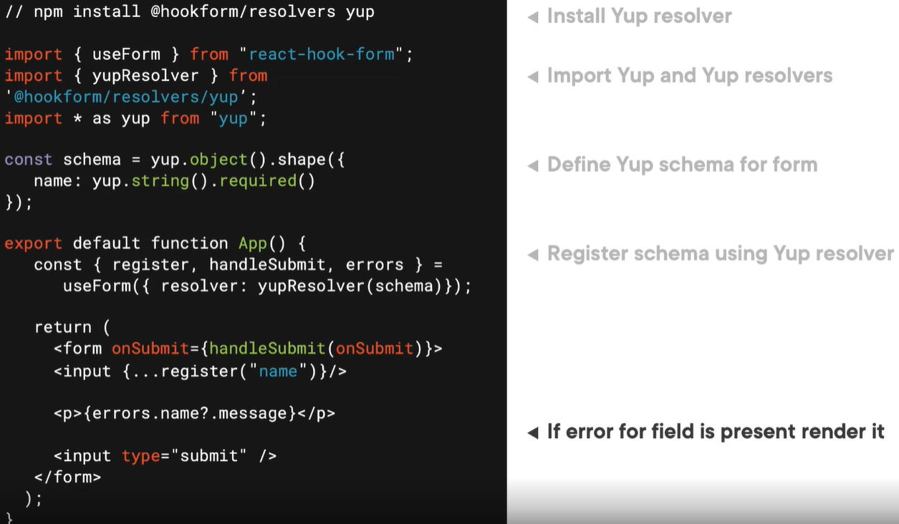
Validation with react hook form
Standard html validation – required, max, min, minLenght, maxLength, pattern, validate
Schema validation

Slide 19
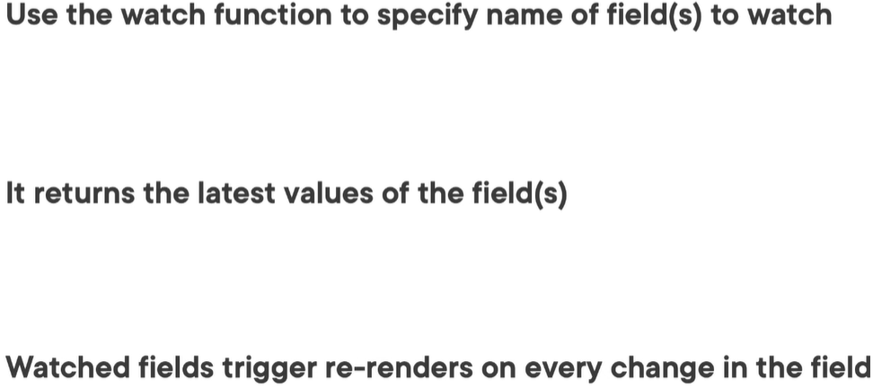
Monitoring vals for instant feedback in react hook form

